Slide 1
Fire & Emergency Services Re-Organization in Eastern Plumas County
A Workshop of the Gold Mountain Community Services District Board of Directors
March 31, 2021

Slide 2
GETTING STARTED
ROLE CALL & ACCEPTANCE OF AGENDA
WORKSHOP FORMAT
GOALS – WHAT WE HOPE TO ACCOMPLISH
HISTORY- GMCSD FIRE SERVICES & FUNDING
WHY RE-ORGANIZATION
UPSIDE/DOWNSIDE EXERCISE
QUESTIONS
NEXT STEPS

Slide 3
GOALS
UNDERSTANDING OF THE FIRE SERVICES RE-ORGANIZATION EFFORT
EXAMINATION OF PROS & CONS OF RE-ORGANIZATION
ABILITY FOR GMCSD BOARD TO MAKE BETTER NFORMED DECISIONS ABOUT FIRE SERVICES OPTIONS

Slide 4
HISTORY OF FIRE SERVICES & FUNDING
GOLD MOUNTAIN CSD

Slide 5
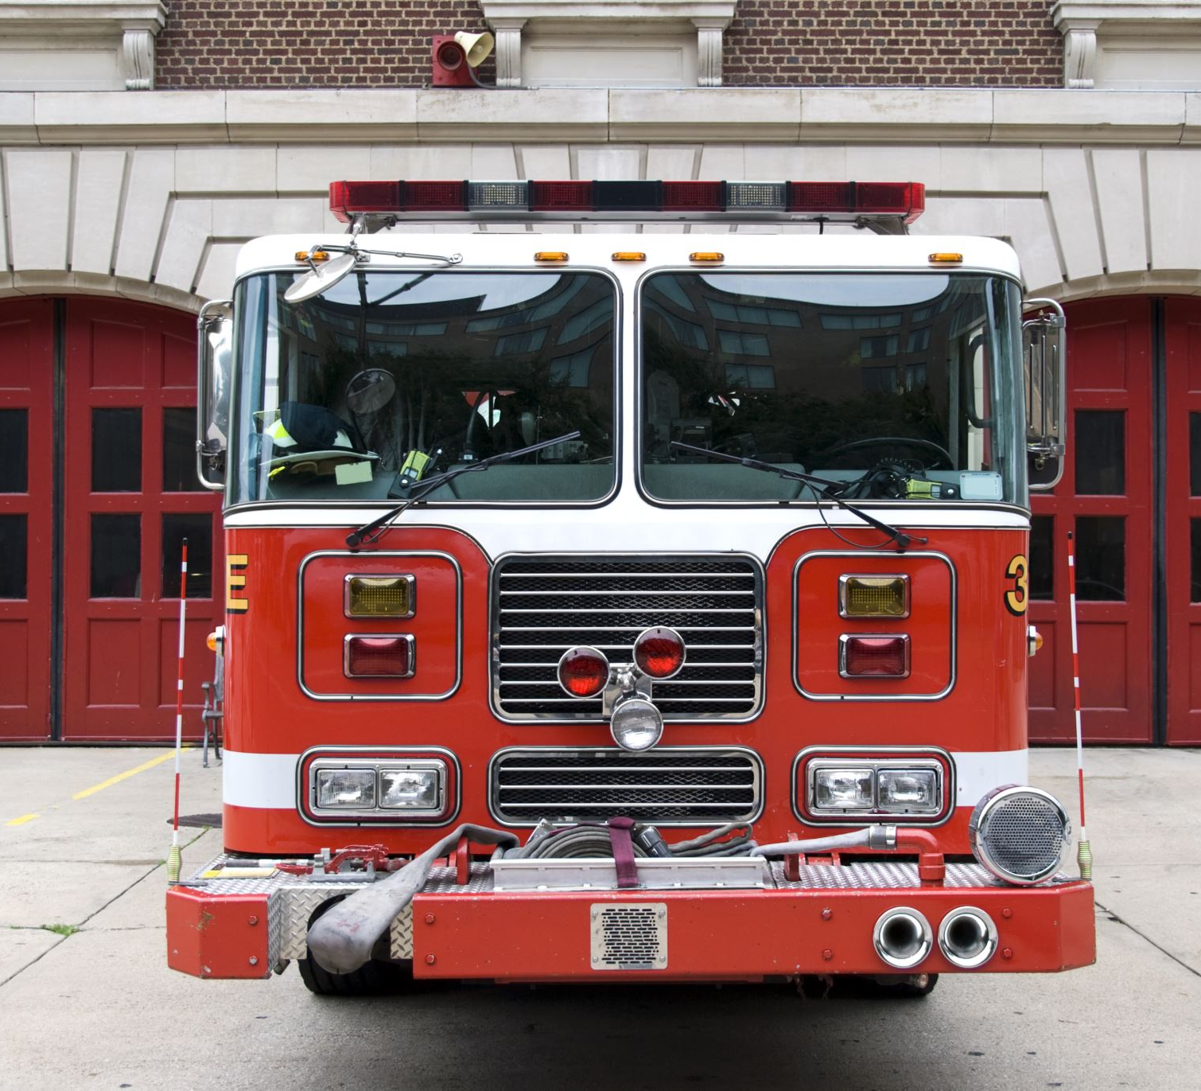
HISTORY
2006-2019 – Contract for fire and emergency services from City of Portola
2009 – Study by GMCSD for Selection of a Long-Term Fire Services Provider and Annexation Options
Post 2009 Study – Requirement to Annex rescinded
2019-Current – Contract for fire and emergency services from Eastern Plumas Rural Fire Protection District

Slide 6
HISTORY OF FIRE SERVICES FUNDING - GMCSD
1998 – Plumas County failed to initiate a property tax sharing agreement with the developers of the Gold Mountain community. Tax Sharing from property taxes paid to the CSD is intended to support fire protection and emergency medical response to the Nakoma community.
2006 - Special Fire Tax Ballot Measure passed by two-thirds vote of the electorate residing in the District for the purpose of funding fire protection, emergency medical response, fire prevention and fire infrastructure. Brings GMCSD into compliance with Prop. 218.
2007 – GMCSD negotiated with Plumas County to initiate a tax sharing agreement. Based on historic high valuations in 2006/07, property values in the community plummeted from the baseline resulting in a “failed” tax sharing agreement with the County.

Slide 7
Purpose of special fire tax use
OPERATIONS –
Fire Protection Contract, insurance, supplies, equipment facility
ADMINISTRATION –
Salaries, office space, office equipment & supplies
HFT –
Fuel breaks, CSD & HOA owned properties. Fuel treatment projects benefiting the community
EQUIPMENT –
4-wheel drive quick attack vehicle, mobile water tender, tools
FACILITIES –
District facility or contribution to facilities of agencies the District may contract with or to which it may annex
FIRE INFRASTRUCTURE IMPROVEMENTS –
Hydrants, pumps, distribution
EDUCATION –
Fire prevention and preparedness. Evacuation and communications

Slide 8
why re-organization?
The Six Agencies – City of Portola, Eastern Plumas Rural Fire, Beckwourth Fire, Sierra Valley Fire, C-Road Community Services District, Gold Mountain Community Services District

Slide 9
CHALLENGES TO VOLUNTEER FIRE SERVICES
Lack of sufficient funding
Disjointed services with lack of consistency amongst providers
Areas outside of boundaries of designated local fire provider, yet receiving services for no cost
Duplication of services – Administrative, Governance
Divides voices which limits influence
Lack of regional planning for location and type of facilities and equipment
Lack of volunteerism

Slide 10
CHALLENGES TO VOLUNTEER FIRE SERVICES
Unrealistic expectations placed on volunteer fire chiefs
Competition for Grant funding
Fire inspection duties specified under law not uniformly performed
Vacancies on fire district boards
Lack of long-range planning
What Else?

Slide 11
FIRE SERVICES OPTIONS
WHY FORMATION OF A NEW FIRE DISTRICT?

Slide 12
Annexation *Agencies collapse into one surviving agency
PROS
CONS
Better leveraging of resources
Elimination of duplications, such as, administrative & governance
Improved consistency on policy and practices
Does not address funding concerns of many providers
Governing body of dissolved agency ceases to have control
Differences in funding levels of two agencies may cause challenges
Does not address areas outside of LAFCO approved boundaries

Slide 13
Consolidation of 2 or more agencies *ONE AGENCY IS SUCCESSOR AGENCY WHILE ALL OTHERS CEASE TO EXIST
PROS
CONS
Better leveraging of resources
Elimination of duplication
Improved consistency on policies and practices
Regional planning and implementation
Allows for input of local representatives if so negotiated
Does not address funding concerns of many providers
Differences in funding levels of agencies may cause challenges
Does not address areas outside of approved LAFCO boundaries

Slide 14
formation of new regional fire district *An entirely new agency is formed and other providers dissolved
PROS
CONS
Fresh start by creating new logical boundaries
Could address funding with tax measure on election ballot and includes all served properties
Better leveraging of resources
Eliminations of duplications
Improved consistency on policies and practices
Regional planning and implementation
Costs shared across multiple agencies
Longer and more expensive process

Slide 15
Joint powers agreement *Agreement between agencies to jointly manage fire Services For some or all services
PROS
CONS
Better leveraging of resources
Elimination of duplications
Improved consistency on policies and practices
Regional planning on implementation
Allows for continued input from local representatives
No LAFCO fees
Courting before marriage
It is whatever is made of it
Could overcome funding differences
Does not address funding concerns of many providers
Does not address areas outside of LAFCO approved boundaries
Often ends in dissolution

Slide 16
CONTINUE TO CONTRACT FOR SERVICES *option exists to gmcsd only if Re-Organization does not occur
PROS
CONS
Path of least resistance
No LAFCO fees
No change in status quo – Service level remains unchanged
Does not address funding concerns of many providers
Locks agencies into agreements
Does not include areas outside of LAFCO approved boundaries
No representation on provider Board
Continued contract cost escalation

Slide 17
Formation of a brand New fire district
UPSIDE/DOWNSIDE
GMCSD & Nakoma Community

Slide 18
WHAT HAPPENS – IF?
Feasibility Study does not support formation of a new fire district?
Participating agencies decide to withdraw from the Study Group?

Slide 19
DISCUSSION/QUESTIONS
NEXT STEPS

